Slide 1
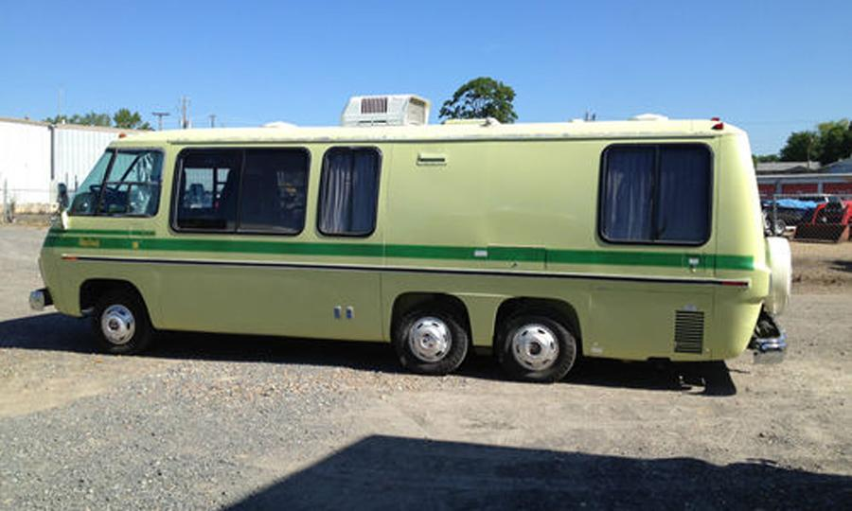
Why Separate Code into Layers?

Slide 2




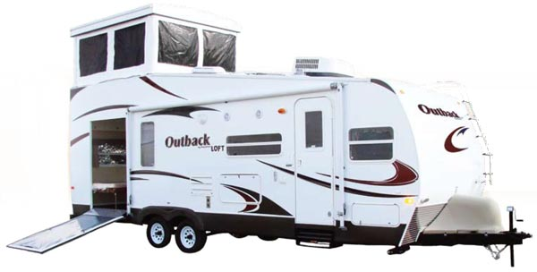

Separation provides options:

Slide 3
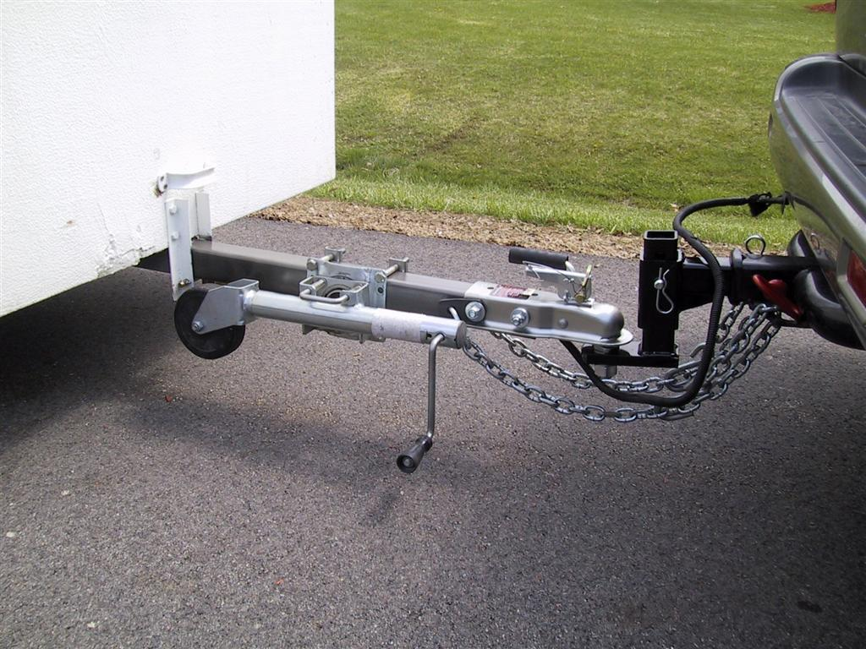
Separation is achieved by allow items to be decoupled:

Slide 4
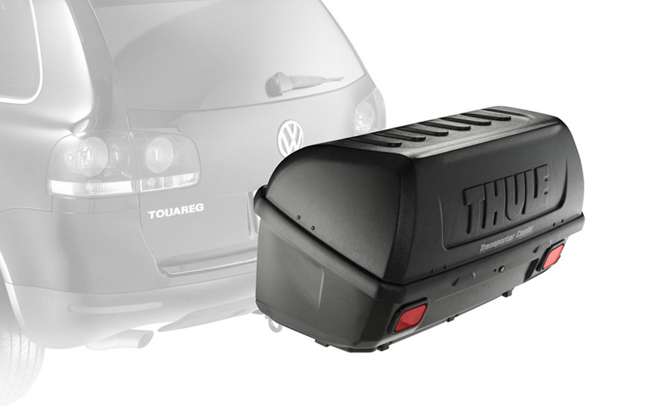
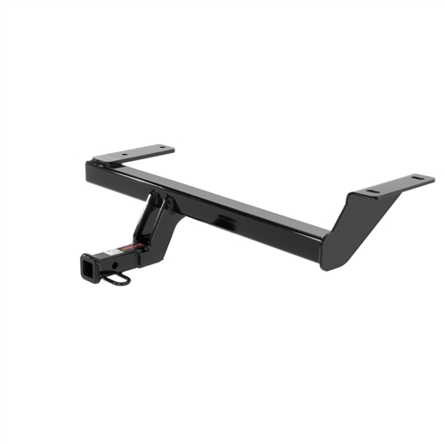
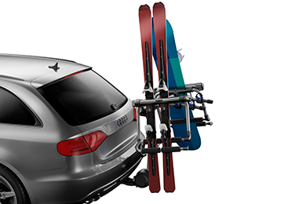
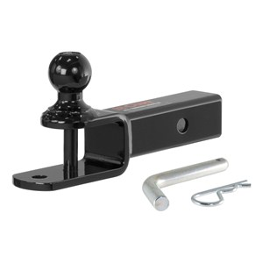
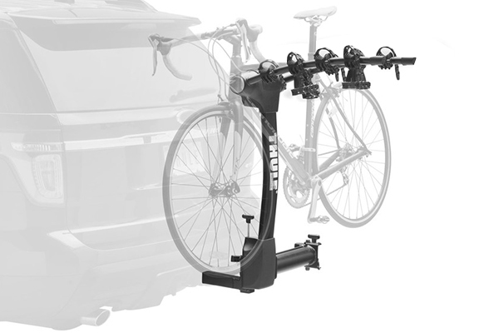
Addition levels of decoupling can add even more flexibility

Slide 5
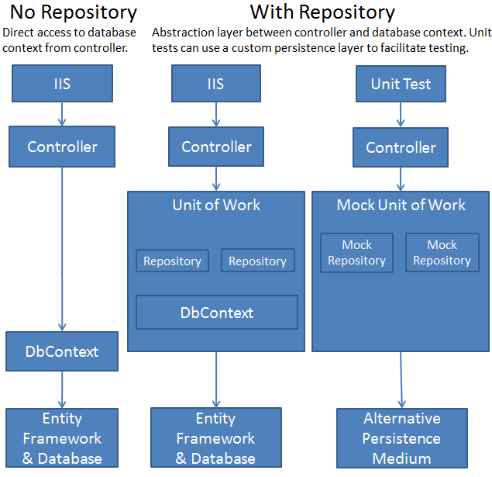

The same is true with code!

Slide 6
Some repository pattern resources:
http://www.asp.net/mvc/tutorials/getting-started-with-ef-using-mvc/implementing-the-repository-and-unit-of-work-patterns-in-an-asp-net-mvc-application
Pluralsight videos:
John Papa Single Page Apps with HTML5, Web API, Knockout and jQuery
Shawn Wildermuth Building a Site with Bootstrap, AngularJS, ASP.NET, EF and Azure

Slide 7
How this fits in with other aspects of App Dev
Application Coding
Build and Deploy
^

Slide 8
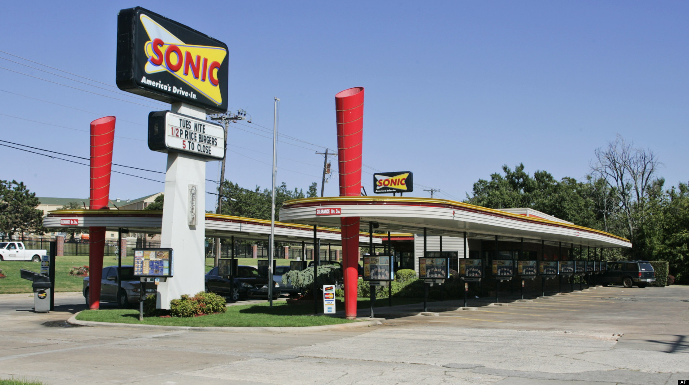
Automated Build

Slide 9

Automated Deployment

Slide 10

Continuous Integration

Slide 11

Dependency Injection

